Slide 1
PSCS235 - Tourism Data Exploration: Analysis and Visualization for Impactful Insights
PIP2001 Capstone Project
VIVA VOCE
Batch Number: G45
Under the Supervision of,
Ms. Sreelatha P.K
Assistant Professor
School of Computer Science and Engineering
Presidency University
Roll Number | Student Name
20211CSE0846 | VAISHNAVI C
20211CSE0298 | SHRUTHI V
20211CSE0308 | RUTHIKA S SHETTY
Name of the Program: CSE
Name of the HoD: Dr. Asif Mohammed H.B
Name of the Program Project Coordinator: Mr. Amarnath J.L & Dr. Jayanthi. K
Name of the School Project Coordinators: Dr. Abdul Khadar A

Slide 2
Introduction
This project aims to create an innovative data mining solution capable of accurately forecasting tourists' travel preferences, specifically optimizing domestic tour packages' scheduling.
This project leverages Artificial Intelligence (AI) and Machine Learning (ML) to analyze tourist data. Using clustering and predictive modelling, the study identifies trends, segments destinations, and provides actionable insights for improved tourism planning. By employing algorithms such as K-Means for clustering and Principal Component Analysis(PCA) for predictive modelling, the project aims to revolutionize tourism management by offering sustainable, personalized, and efficient solutions.

Slide 3
Literature Review
Algorithms Used: Various advanced algorithms such as Knowledge Graphs, AI-based models (e.g., TOPSIS, ABC), Neural Networks (ANN, MLP), Support Vector Machines (SVM), and ensemble techniques like Random Forests were implemented to analyze and predict tourism trends.
Data Sources: Studies relied on diverse datasets, including open government data, climate databases (NOAA), social media data (Facebook, TripAdvisor), and retail campaign records, combining structured and unstructured sources.
Forecasting and Personalization: Predictive models focused on tourism demand forecasting using both traditional data and real-time social media inputs, enhancing accuracy and enabling tailored recommendations for tourists.
Hybrid Models: Many papers utilized hybrid algorithms(e.g., ABC + Fuzzy TOPSIS, Gradient Boosting with BERT) to improve decision-making and forecasting, offering a competitive edge over single-method approaches.
Impact on Tourism: These studies aim to optimize tourism operations through better forecasting, smart destination management, personalized recommendations, and actionable insights, contributing to sustainable tourism growth.

Slide 4
Literature Review
Advantages:
- Enhanced accuracy in predictions and recommendations.
- Integration of multi-source data helps stakeholders in tourism planning.
- Models account for disruptions, such as the COVID-19 pandemic, improving adaptability.
Challenges and Disadvantages:
- High computational demand and complexity in algorithms.
- Overreliance on specific datasets (like TripAdvisor) may limit generalizability.
- Data quality and privacy concerns arise when using social or retail data.

Slide 5
Existing method Drawback
Scalability and Data Integration Challenges
Limitations in Real-Time Application
Dependence on Specific Data Sources
Scalability and Adaptability Challenges
Limited Data Interoperability and Analytics
Weak Crisis Management Capabilities

Slide 6
Proposed Method
Data Collection
- Sources: travel review platforms (Reviews), and tourism-related websites.
- Purpose: Captures public sentiment, trending destinations, and personalized user preferences for a comprehensive tourism analysis.
2. Data Pre-Processing
- Cleaning: Removes duplicates, missing values, and irrelevant data.
- Normalization: Standardizes formats (locations) for consistency.
- Feature Extraction: Identifies key attributes like traveler demographics and destination characteristics.
- Purpose: Ensures high-quality, structured data for accurate analysis and predictions.

Slide 7
Proposed Method
3. Machine Learning
- Predictive Models: Forecasts peak seasons, demand shifts, and external influences.
- Clustering Models: Segments tourists based on preferences, budgets, and behaviors for targeted marketing.
- Purpose: Enhances decision-making with AI-driven insights for tourists and industry stakeholders.
4. Visualization
- Tools: Python libraries (Matplotlib, Seaborn) to create graphs.
- Examples:
- Top Destination: Bar charts showing popular tourist spots.
- Seasonal Trends: Line graphs depicting demand fluctuations.
- Purpose: Simplifies data interpretation, enabling actionable insights and better tourism strategies.

Slide 8
Objectives
Objective 1: Develop a Robust Clustering Algorithm for Tourist Data Segmentation Segmentation of tourist data is essential for understanding the diverse needs and preferences of travelers. This objective involves exploring and implementing a variety of clustering algorithms, such as K-Means to categorize tourists into distinct groups based on relevant attributes.
Objective 2: Construct Predictive Models for Forecasting Tourist Travel Clusters Accurate forecasting of tourist trends is crucial for proactive decision-making. This step focuses on developing and evaluating predictive models to predict how tourist clusters evolve over time.
Objective 3: Analyze and Interpret Results from Clustering and Predictive Models Once the clustering and predictive models are implemented, a thorough analysis of the results is essential to derive meaningful insights.
Objective 4: Develop Actionable Recommendations for Tourism Authorities
Using insights derived from clustering and predictive models, actionable recommendations will be provided to tourism authorities to enhance their planning and service delivery.

Slide 9
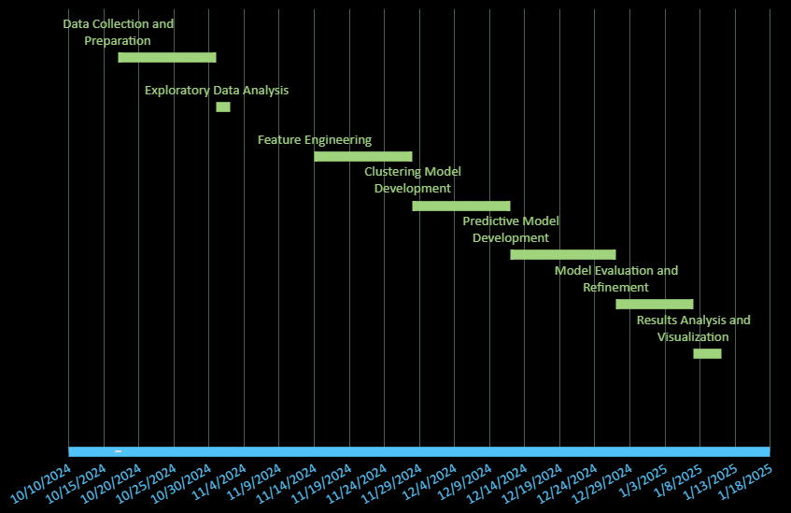
Timeline of Project

Slide 10
Outcomes/Results Obtained
Data Preprocessing: Irrelevant columns were removed, categorical features were label-encoded, and numerical features were normalized for compatibility with clustering algorithms.
Optimal Cluster Identification: The Elbow Method and Silhouette Scores indicated k=4 as the optimal number of clusters, suggesting three distinct groups of destinations. K-Means clustering was applied with three clusters, resulting in four categories: Premium Destinations, Budget-Friendly Spots, Eco-Tourism Potentials, and Underrated Destinations.
Premium Destinations: These cater to affluent tourists, with high ratings, entrance fees, and luxury experiences. Focus on enhancing premium services and exclusive offerings.
Budget-Friendly Spots: Low-cost destinations with moderate ratings, suitable for families and students. Require infrastructure development and targeted marketing to increase visibility.
Eco-Tourism and Underrated Destinations: Eco-tourism spots focus on sustainability and conservation. Underrated destinations have potential for growth with improved infrastructure and marketing efforts.
Clustering & PCA: PCA was used to reduce dimensionality, visualizing well-separated clusters on a 2D scatterplot, reflecting distinct groups with varying ratings, entrance fees, and tourism potential.

Slide 11
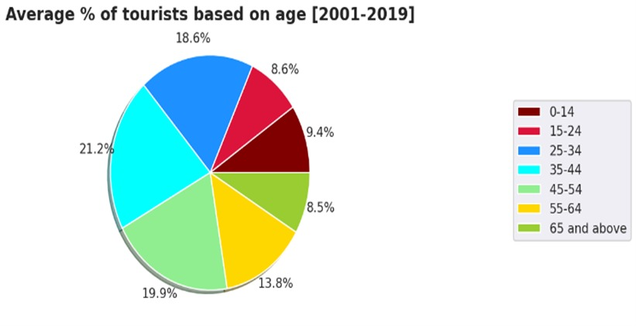
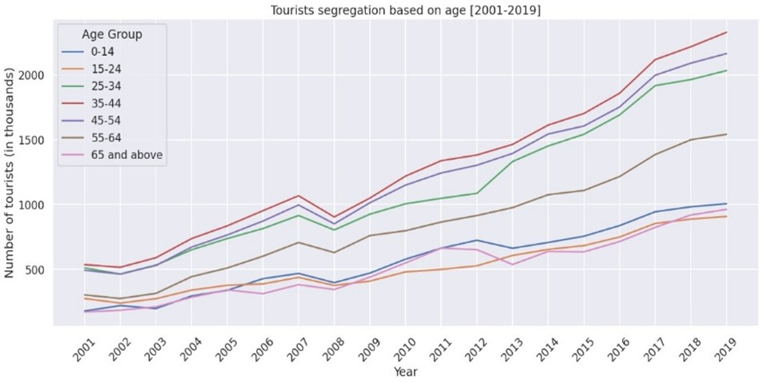
Outcomes/Results Obtained

Slide 12
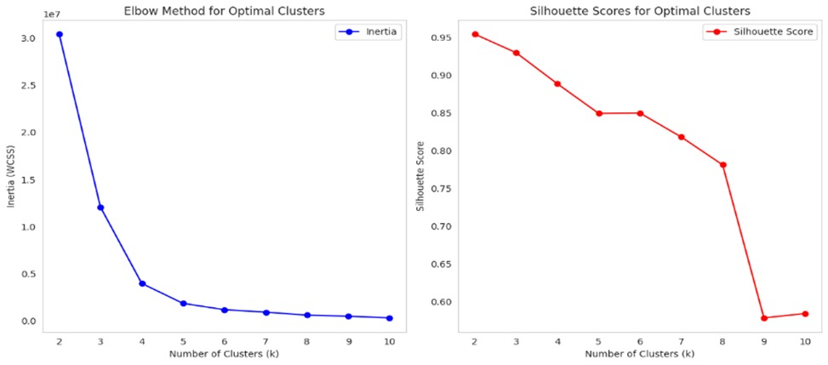
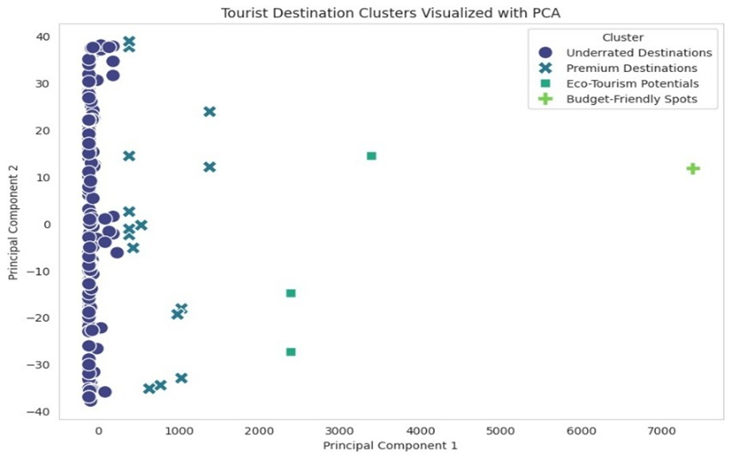
Outcomes/Results Obtained

Slide 13
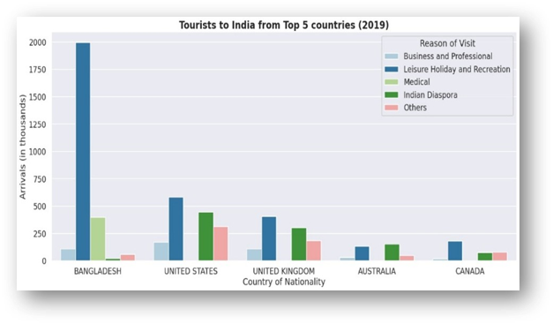
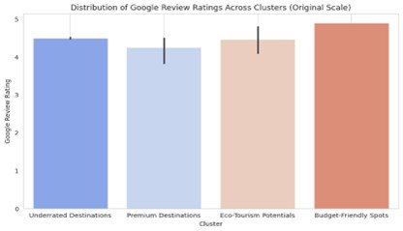
Outcomes/Results Obtained

Slide 14
Conclusion
This project effectively harnesses the power of AI/ML techniques and diverse datasets to analyze, predict, and optimize trends in the Indian tourism sector. By integrating clustering, predictive modelling, and trend analysis, the study provided valuable insights for tourism authorities, stakeholders, and decision-makers.
Predictive models, such as the Principal Component Analysis(PCA), were used to classify destinations based on their significance, leveraging features like regional importance, ratings, and accessibility.
In conclusion, this project highlights the critical role of data-driven decision-making in addressing modern challenges in the tourism industry. It showcases the potential of AI/ML to foster growth, sustainability, and enriched traveler experiences.

Slide 15
GitHub Link
The GitHub link provided should have public access permission.
https://github.com/vaishnavi-c-2025/Tourism-Data-Exploration-Analysis-and-Visualization-for-Impactful-Insights

Slide 16
References
[1]. J. Wu, J. Pierse, F. Orlandi, D. O'Sullivan and S. Dev, "Improving Tourism Analytics from Climate Data Using Knowledge Graphs," in IEEE Journal of Selected Topics in Applied Earth Observations and Remote Sensing, vol. 16, pp. 2402-2412, 2023, doi: 10.1109/JSTARS.2023.3239831.
[2]. O. Alcaraz, A. Berenguer, D. Tomás, M. A. Celdrán-Bernabeu and J. -N. Mazón, "Augmenting Retail Data with Open Data for Smarter Tourism Destinations," in IEEE Access, vol. 12, pp. 153154-153170, 2024, doi: 10.1109/ACCESS.2024.3480326.
[3]. S. Forouzandeh, M. Rostami and K. Berahmand, "A Hybrid Method for Recommendation Systems based on Tourism with an Evolutionary Algorithm and Topsis Model," in Fuzzy Information and Engineering, vol. 14, no. 1, pp. 26-50, March 2022, doi: 10.1080/16168658.2021.2019430.
[4]. T. Peng, J. Chen, C. Wang and Y. Cao, "A Forecast Model of Tourism Demand Driven by Social Network Data," in IEEE Access, vol. 9, pp. 109488-109496, 2021, doi: 10.1109/ACCESS.2021.3102616
[5]. İ. Topal and M. K. Uçar, "Hybrid Artificial Intelligence Based Automatic Determination of Travel Preferences of Chinese Tourists," in IEEE Access, vol. 7, pp. 162530-162548, 2019, doi: 10.1109/ACCESS.2019.2947712.

Slide 17
References
[6]. Ahmed, Nesreen & Gayar, Neamat & El-Shishiny, Hisham, “Tourism Demand Forecasting using Machine Learning Methods”, 2007.
[7]. Ram Krishn Mishra, Siddhaling Urolagin, J. Angel Arul Jothi, Nishad Nawaz and Haywantee Ramkissoon, “Machine Learning based Forecasting Systems for Worldwide International Tourists Arrival” International Journal of Advanced Computer Science and Applications(IJACSA), 12(11), 2021, 10.14569/IJACSA.2021.0121107
[8]. Noelyn M. De Jesus and Benjie R. Samonte, “AI in Tourism: Leveraging Machine Learning in Predicting Tourist Arrivals in Philippines using Artificial Neural Network” International Journal of Advanced Computer Science and Applications(IJACSA), 14(3), 2023, 10.14569/IJACSA.2023.0140393
[9]. Bilal sultan Abdualgalil and Sajimon Abraham, “Tourist Prediction Using Machine Learning Algorithms”, 2020.
[10]. Dinda Thalia Andariesta, Meditya Wasesa, “Machine learning models for predicting international tourist arrivals in Indonesia during the COVID-19 pandemic: a multisource Internet data approach” , Journal of Tourism Futures, 2022, doi: 10.1108/JTF-10-2021-0239

Slide 18
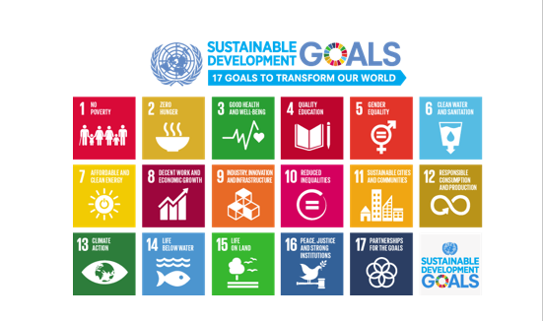
Project work mapping with SDG

Slide 19
Project work mapping with SDG
SDG 8: Decent Work and Economic Growth
Our project enhances the tourism industry by leveraging technology to optimize resources and promote underutilized regions, thereby creating new job opportunities and fostering sustainable economic growth.
2. SDG 11: Sustainable Cities and Communities
Our project contributes to building sustainable communities by implementing data-driven insights for better urban infrastructure around tourist destinations, promoting eco-friendly and sustainable tourism practices.
3. SDG 12: Responsible Consumption and Production
Our project ensures responsible tourism by recommending balanced tourist distribution across regions, reducing the environmental strain on over-visited areas and promoting eco-tourism alternatives.
4. SDG 17: Partnerships for the Goals
Our project fosters collaboration among stakeholders, such as tourism boards, businesses, and data platforms, ensuring a unified effort toward achieving sustainable development goals.

Slide 20
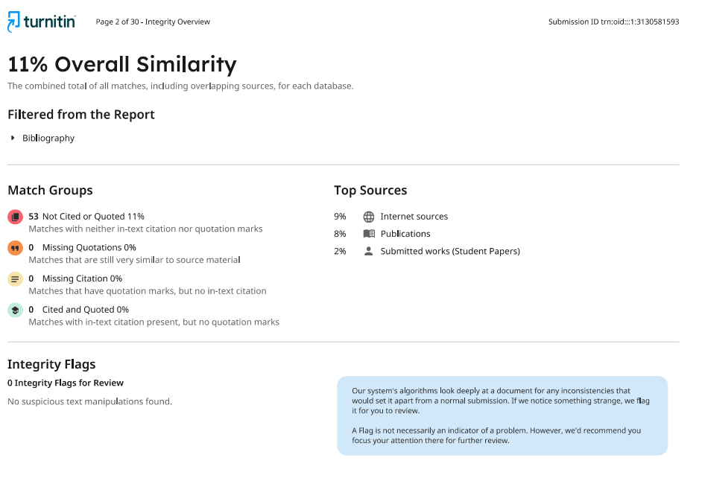
PLAGIARISM RESULT OF THE REPORT

Slide 21
Thank You

